Slide 1
WHPSC 2022 Sun-Sat, September 11-17
Results Screenshots from Jun Nogami’s blog (which contained screenshots of the Excel file results)

Slide 2
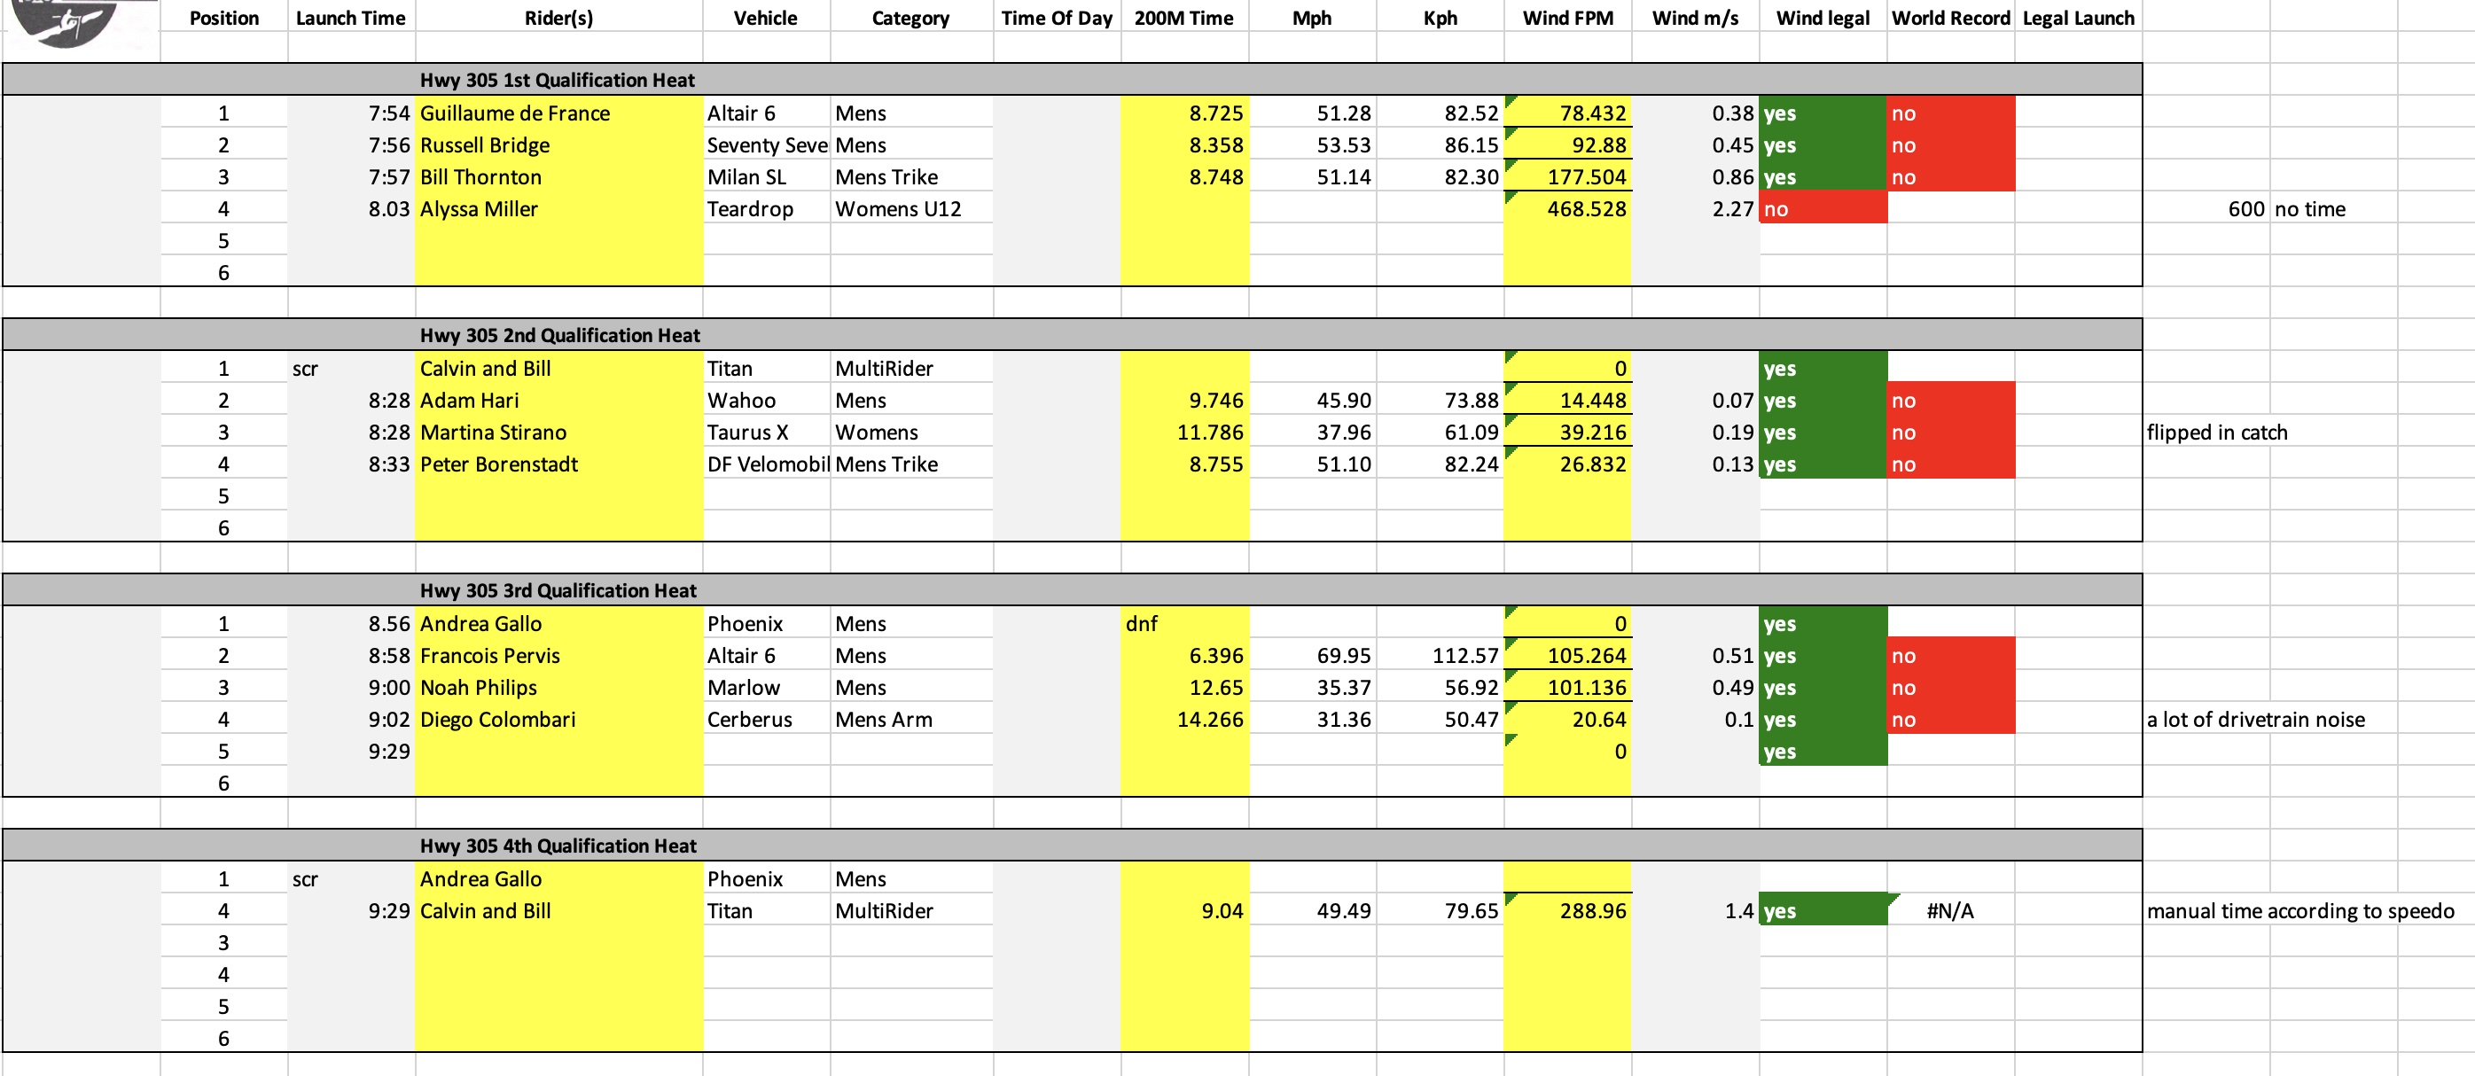
WHPSC 2023: Sunday AM

Slide 3
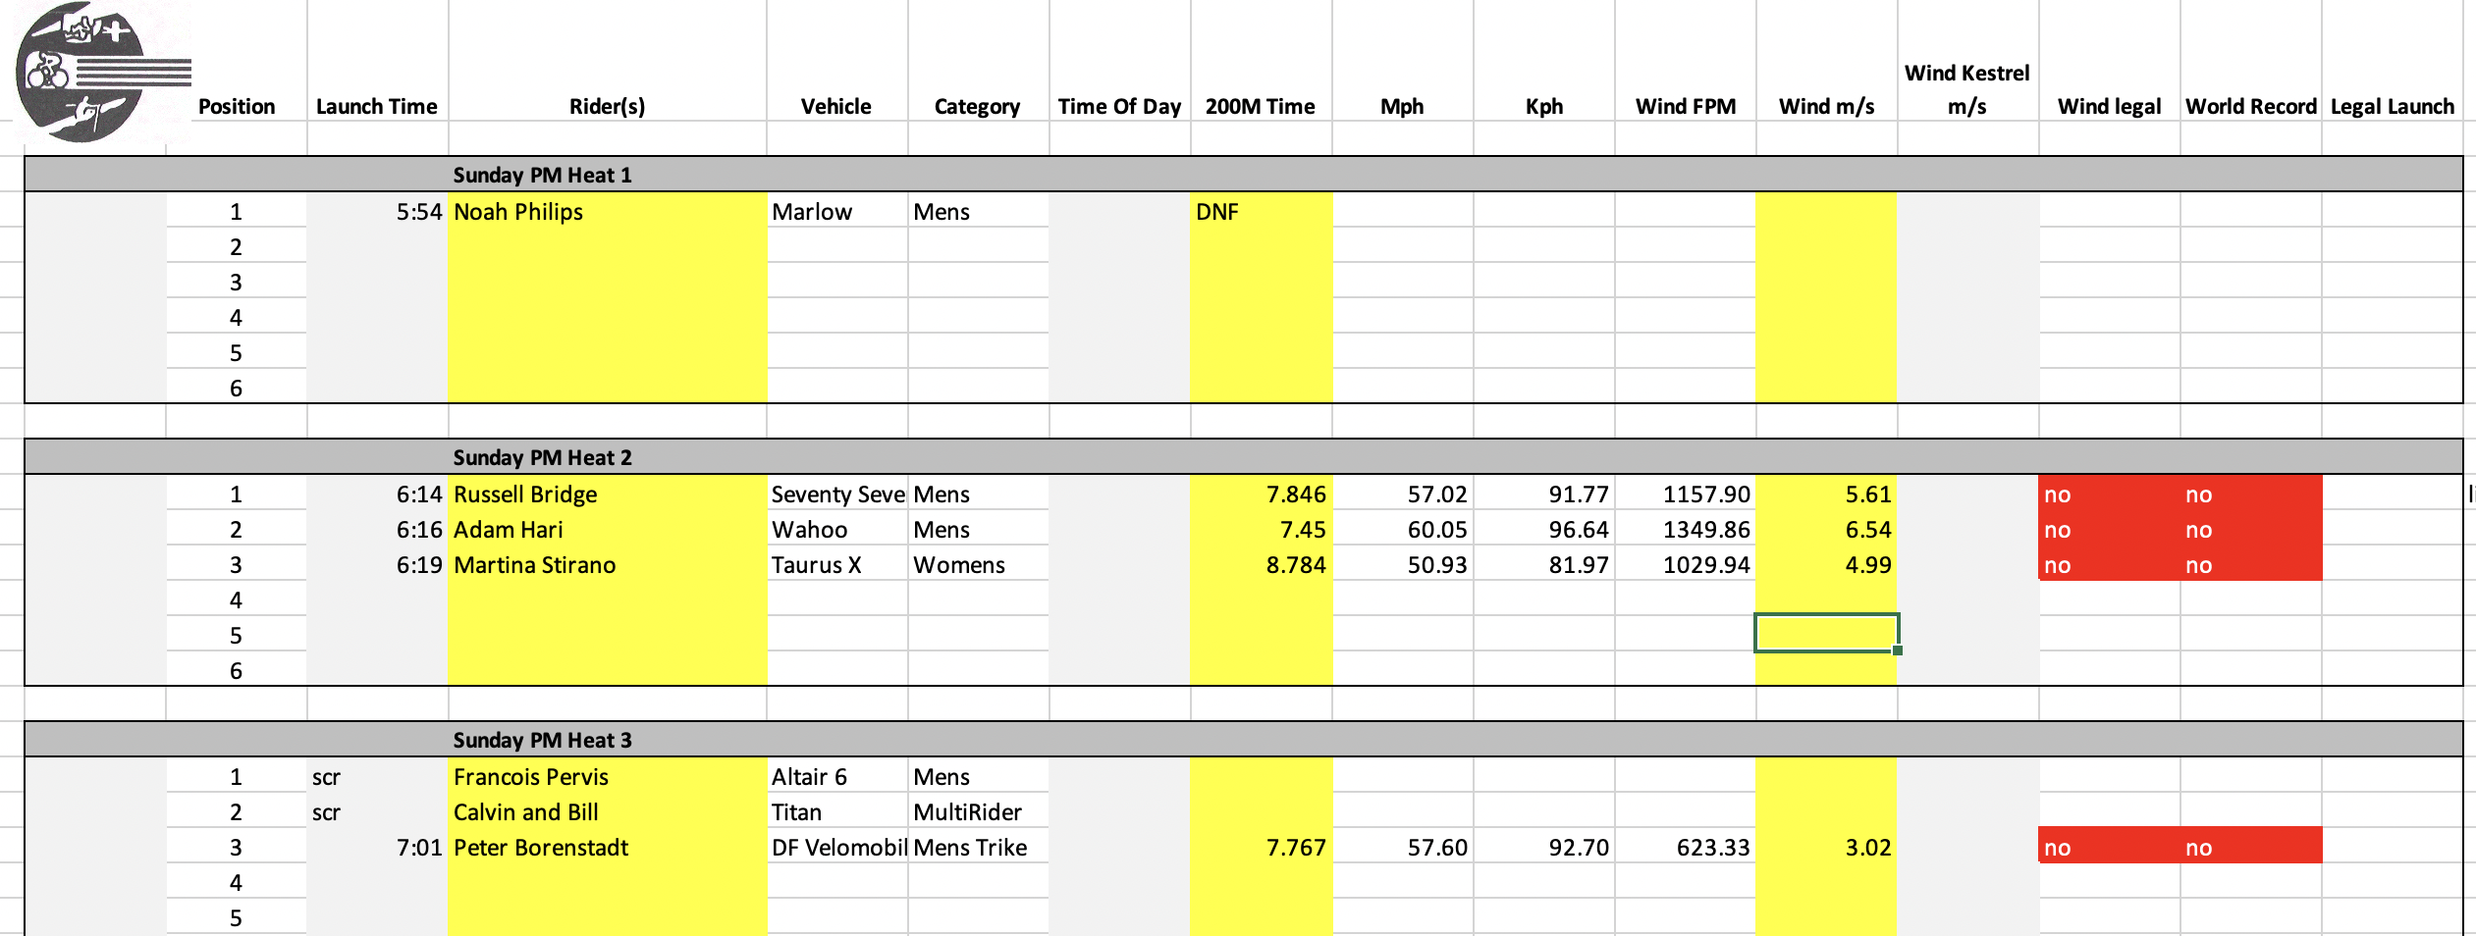
WHPSC 2023: Sunday PM

Slide 4
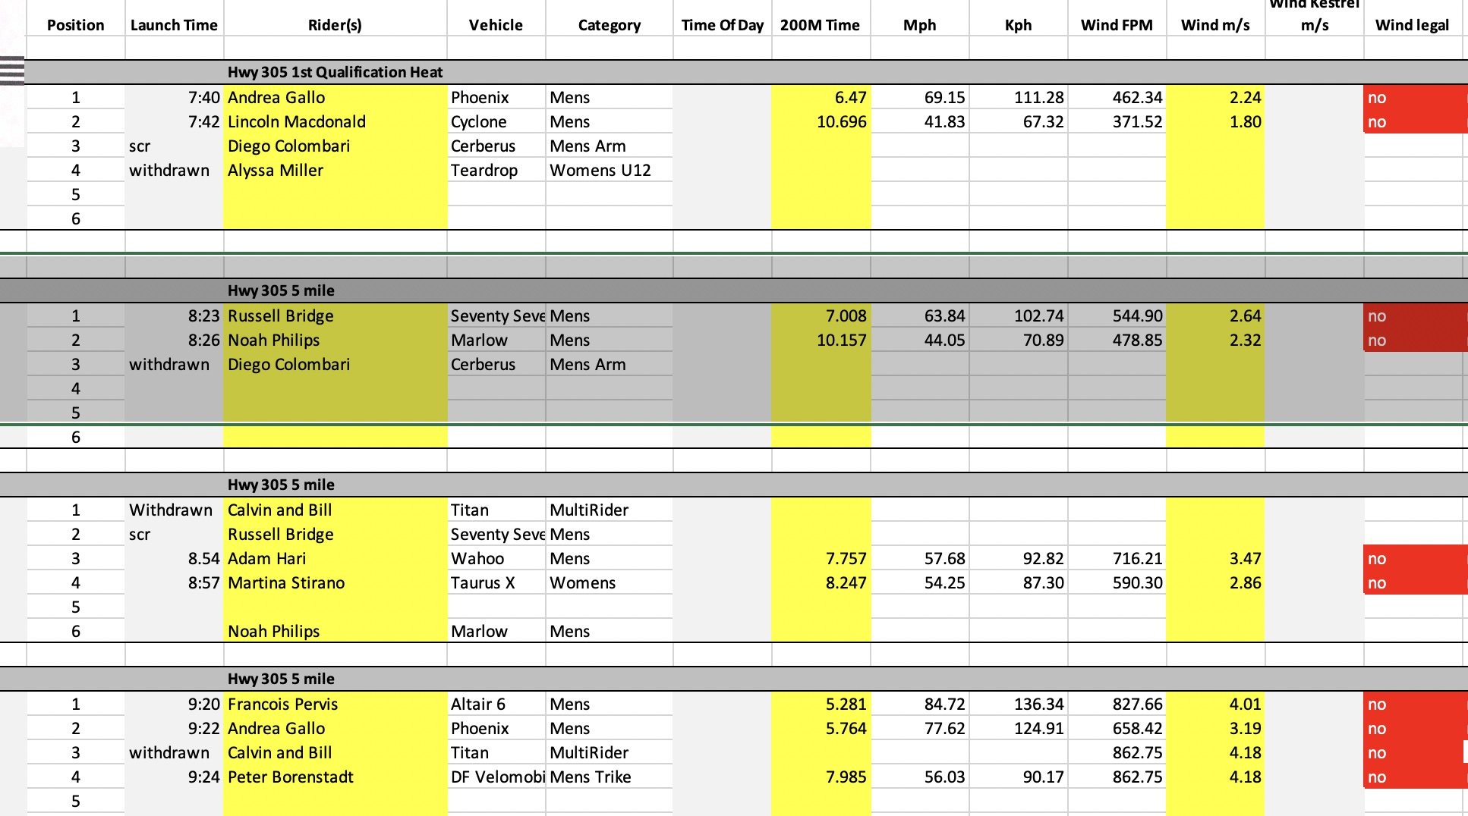
WHPSC 2023: Monday AM

Slide 5
WHPSC 2023: Monday PM – All runs cancelled

Slide 6
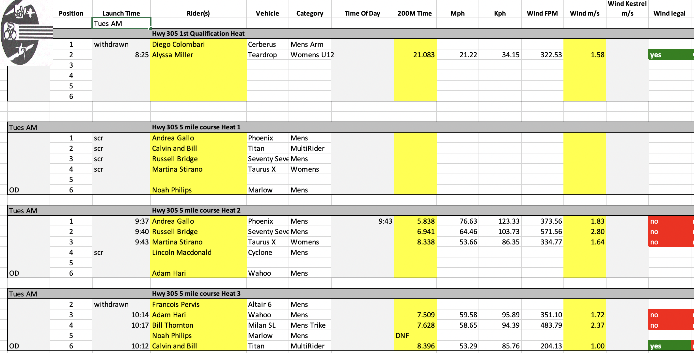

Slide 7
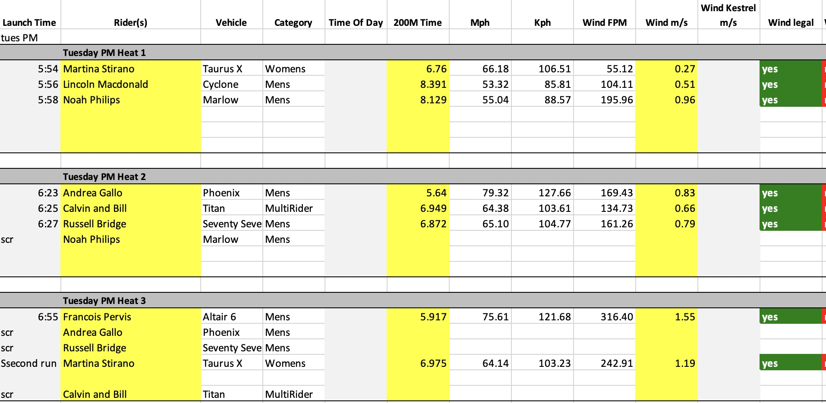

Slide 8
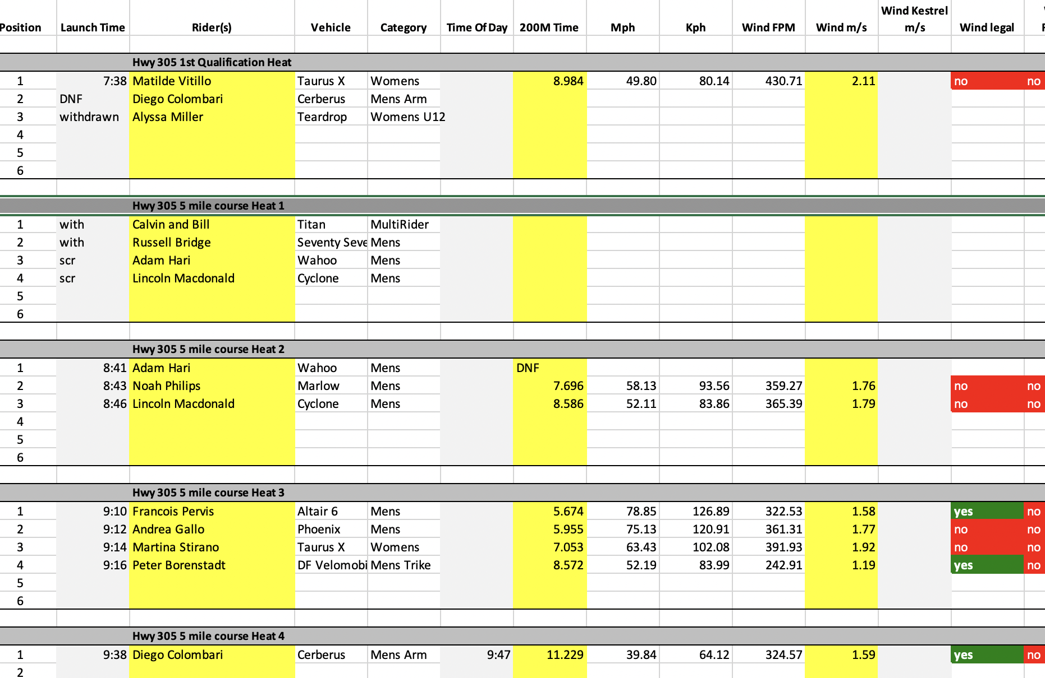
WHPSC 2023: Wednesday AM

Slide 9
WHPSC 2023: Wednesday PM – All runs cancelled

Slide 10
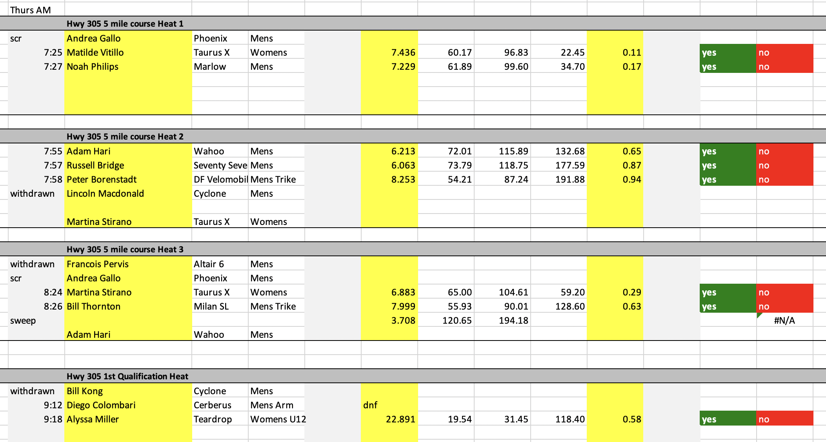

Slide 11
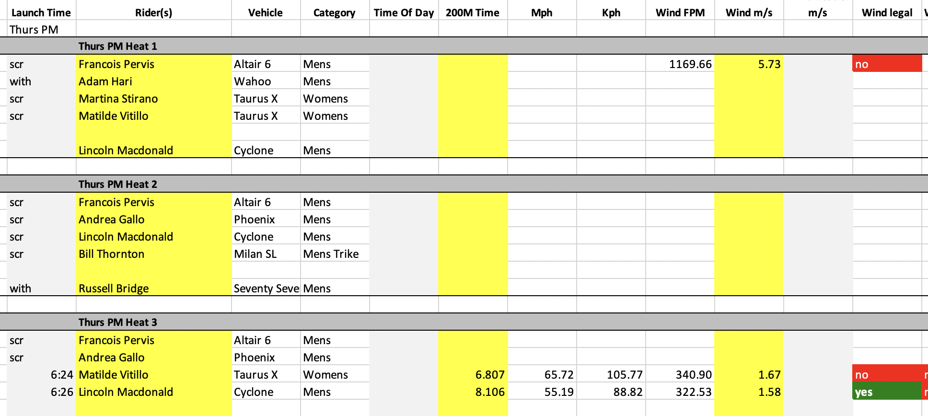

Slide 12
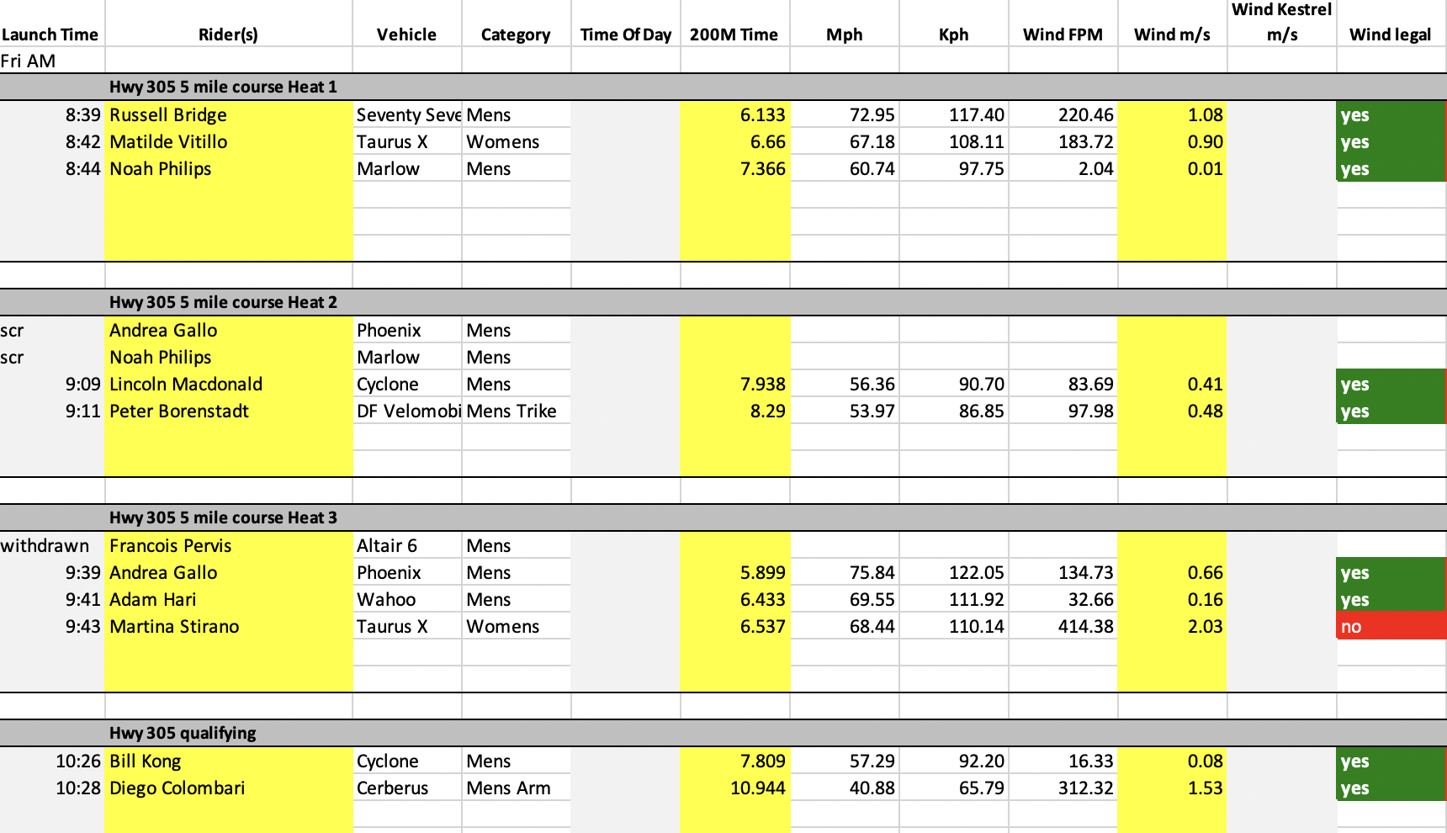

Slide 13
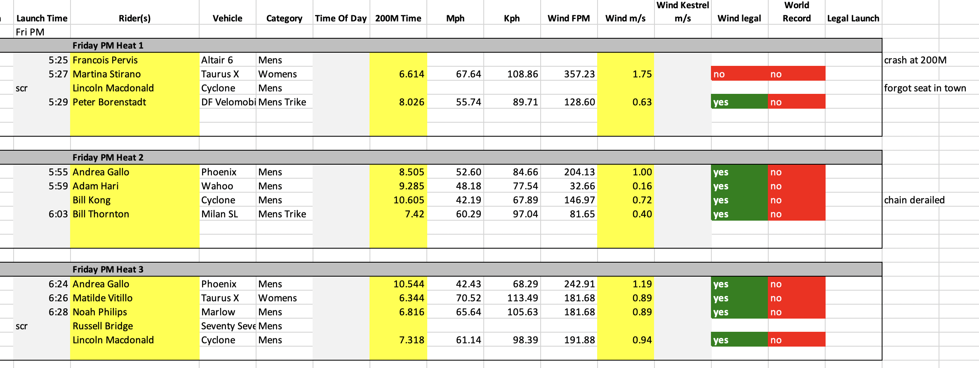

Slide 14
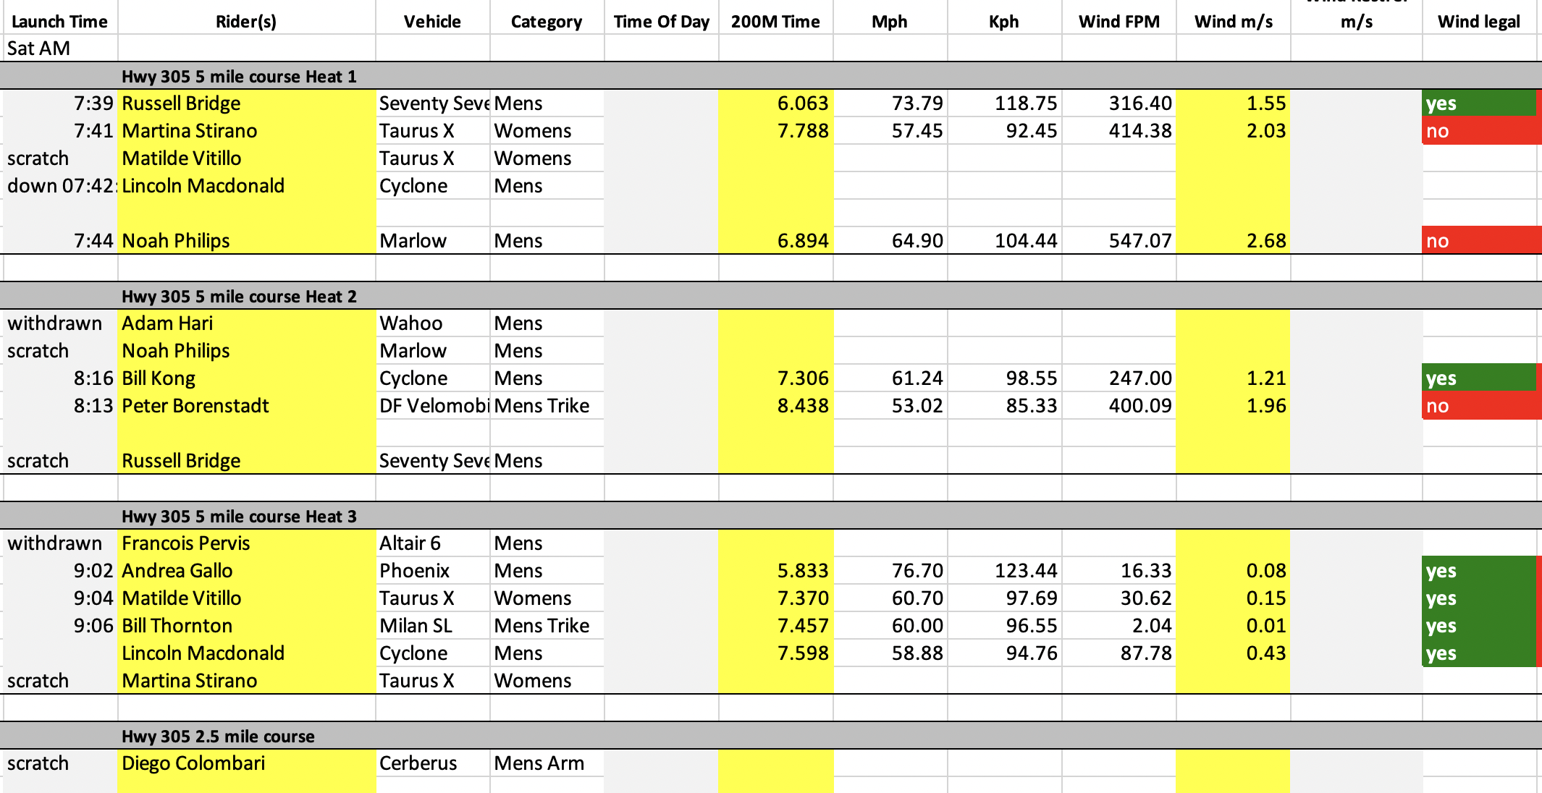

Slide 15
